Slide 1
Dynamic Programming
Module 3

Slide 2
Why should you apply dynamic programming to solve Markov Decision Process?
Bellman equations are recursive in nature. You can break down Bellman equation to two parts – (i) optimal behaviour at next step (ii) optimal behaviour after one step
You can cache the state value and action value functions for further decisions or calculations.

Slide 3
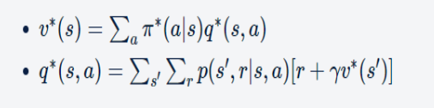
Dynamic Programming (DP) is a method of solving complex problems by breaking them into sub-problems. It solves the sub-problems and stores the solution of sub-problems, so when next time same subproblem arises, one can simply look up the previously computed solution.
Used to solve the Bellman equation, which is a recursive equation that expresses the expected value of a state or action as a function of the expected value of the next state or action.
The basic assumption is that: model of the environment p(s′,r|s,a) is available.

Slide 4
Policy iteration is dynamic programming algorithm used in reinforcement learning that involves iteratively improving a policy until it converges to the optimal policy. It involves two steps: policy evaluation and policy improvement.
Value iteration is an example of dynamic programming algorithm used to solve Markov Decision Process (MDP) problems by iteratively updating the value function of each state until convergence. It involves updating the value function using the Bellman equation until it converges to the optimal value function.

Slide 5
Policy Iteration
Policy iteration has three main steps:
Initialize a policy randomly
Policy Evaluation:
Measure how good that policy is by calculating the state-values vπ(s) corresponding to all the states until the state-values are converged.
Also known as the prediction problem.
Policy Improvement:
Make changes in the policy you evaluated in the policy evaluation step.
Also known as the control problem.

Slide 6
Question?
One of the aspects of dynamic programming is to store the solution for sub-problem and re-use it later. Which of following statements are correct?
Prediction problem is one of the subproblems in Policy Iteration, where the state-values evaluated are stored to be used later for Policy Improvement
Control Problem is another subproblem in Policy Iteration where it solves the equation recursively to arrive at optimal policy
Control Problem is one of the subproblems in Policy Iteration, where the state-values evaluated are stored to be used later for Policy Improvement

Slide 7
Algorithm
We have assumed that you know the model of the environment - p(s′,r|s,a) So the value functions change to include this term.
There are two basic steps in policy iteration:
Policy Evaluation (Prediction) – Evaluate the policy π by calculating the state value functions vπ(s). Calculate the state-values until convergence.
Policy Improvement (Control) – Improve the policy by choosing the action with maximum state-action value qπ(s,a) in each state.

Slide 8
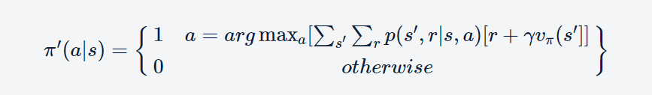
Policy Improvement
Once the value function vπ(s) is evaluated, the agent improves the policy. The improvement is made greedily with respect to the current value functions. In state s, that action is chosen which has the maximum state-action value, i.e. maximum qπ(s, a) value:
If there is no improvement in the policy, then the agent is already at the optimal policy. Else, we need to evaluate the improved policy until the state-values converge and then perform the policy improvement step on top of it. These steps are repeated until there is no further improvement in the policy.

Slide 9


Value Iteration
Value Iteration is a dynamic programming algorithm used to solve for the optimal value function and optimal policy of a Markov Decision Process (MDP). It is an iterative algorithm that starts with an arbitrary value function estimate and updates it in a way that converges to the optimal value function and policy. These state-values are corresponding to the action that yields the maximum state-action value. The state-value function is a greedy choice among all the current actions:
Policy improvement is an implicit step in state-value function update. The update step combines the policy improvement and (truncated) policy evaluation steps.
Once the optimal value function is found, the optimal policy can be easily derived by taking the action that maximizes the state-action value for each state:

Slide 10
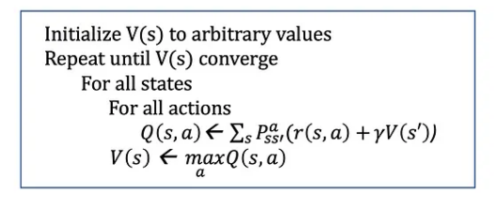

Slide 11
Policy iteration and value iteration are two dynamic programming algorithms used to find the optimal policy in a Markov Decision Process (MDP). Here are some comparisons of their strengths and weaknesses:
Strengths of Policy Iteration:
Converges to the optimal policy faster than value iteration in some cases.
Can handle a larger class of MDPs than value iteration, including those with stochastic policies.
More stable and less sensitive to the choice of the discount factor.
Weaknesses of Policy Iteration:
Can be computationally expensive, especially for large state spaces, because it involves iterative policy evaluation and policy improvement steps.
Can get stuck in local optima, depending on the starting policy.
May not converge if the MDP has infinite horizon.

Slide 12
Strengths of Value Iteration:
Simpler and easier to implement than policy iteration.
Converges to the optimal value function faster than policy iteration in some cases.
Can handle MDPs with infinite horizon.
Weaknesses of Value Iteration:
May require a large number of iterations to converge to the optimal value function in some cases.
Can be sensitive to the choice of the discount factor, especially for MDPs with long horizons.
Cannot handle stochastic policies directly.
Overall, policy iteration is more powerful and flexible than value iteration, but may be slower and more computationally expensive. Value iteration is simpler and faster in some cases, but has more limited applicability. The choice of algorithm depends on the specific problem and trade-offs between computational complexity and speed of convergence.

Slide 13
Generalised Policy Iteration (GPI)
Policy Iteration and Value Iteration are two sides of a coin.
In policy iteration, you complete the entire policy evaluation to get the estimates of value functions for a given a policy and then use those estimates to improve the policy. And then repeat these two steps, until you arrive at optimal state value function.
In value iteration, for every state update, you’re doing a policy improvement, i.e., updating the state value by picking the most greedy action using current estimates of state-values

Slide 14
Generalized Policy Iteration, on the other hand, is a more general framework that allows different types of reinforcement learning methods to be combined in a flexible way. The basic idea is to alternate between two types of steps: policy evaluation and policy improvement. During policy evaluation, the value function is estimated using some method, such as Monte Carlo, Temporal Difference or Bellman Equation. During policy improvement, the policy is updated to be greedy with respect to the estimated value function. GPI can involve any combination of policy evaluation and improvement methods, and it can be adapted to many different types of reinforcement learning problems.

